Slide 1
Part 1: ASR - Automatic Speech Recognition
Building Conversational AI Applications

Slide 2

About Me
Instructor Name – Instructor Contact (e.g. LinkedIn / email)
About instructor 1
About instructor 2
About instructor 3

Slide 3
Course Timeline
8:50 | — | 9:00 |  | Welcome
9:00 | — | 10:00 |  | Lecture 1
10:00 | — | 11:00 |  | Lab 1
11:00 | — | 11:15 |  | Break
11:15 | — | 12:15 |  | Lecture 2
12:15 | — | 13:15 |  | Lab 2
13:15 | — | 14:00 |  | break
14:00 | — | 15:00 |  | Lecture 3
15:00 | — | 16:00 |  | Lab 3
16:00 | — | 17:00 |  | Assessment support

Slide 4
Course Agenda
Part 1: ASR - Automatic Speech Recognition Lecture: Challenges of conversational AI applications, building blocks, ASR (automatic speech recognition) focus Lab: Investigate ASR pipeline with NeMo and Riva
Part 2: TTS – Text To Speech and Conversational AI Customization Lecture: How can we take advantage of conversational AI platforms to build custom applications? Lab: Investigate the TTS pipeline with NeMo and Riva; then build a full custom conversational AI pipeline.
Part 3: Production Deployment Lecture: Discussion of production deployment considerations including an overview of NVIDIA Triton Inference Server and TensorRT. Lab: Hands-on deployment of an example application using Helm and Kubernetes; includes profiling the application.

Slide 5
Part 1
ASR (Part 1)
Lecture
What is Conversational AI? Complexity of Deploying Conversational AI Applications
Deep Learning Fundamentals
Speech and Text Processing
Automatic Speech Recognition
ASR Tools: Riva, NGC, and NeMo
Lab Overview
Lab
Investigate ASR Pipeline with NeMo and Riva

Slide 6

Notes:
Tokkio for Talking Kiosk
https://www.nvidia.com/en-us/on-demand/session/gtcfall21-d31017/

Slide 7


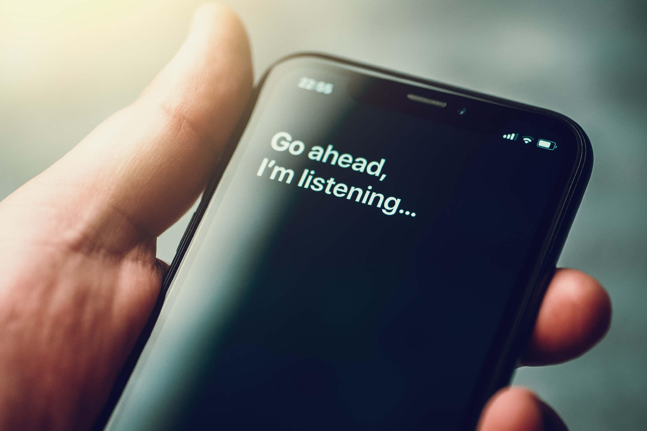
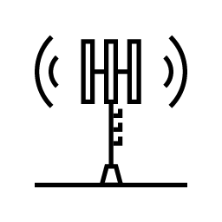



Automatic Speech Recognition Is Everywhere!
Hundreds of billions of minutes of speech generated daily
Call Center
500M Calls Daily
Consumer Apps
1.8B Daily Minutes
Online Meetings
200M Daily
Telecom
Finance
Healthcare
Retail

Slide 8
Building Conversational AI Applications is Not Trivial

Slide 9
Challenges
New models , domain-specific accuracy, complex pipelines, real-time responses
HIGH ACCURACY
REAL-TIME RESULTS
SCALABLE DEPLOYMENT
CUSTOMIZATION
DATA SOVEREIGNTY
Lack of access to state-of-the-art speech algorithms and models
Require low-latency for natural interactions
Limited support for deployment platforms
Limited support for scaling to multiple client requests
Limited model, domain, and pipeline customization
Limited control over the proprietary data used for training and inference
Notes:
Accuracy and latency
customization
Scaling:
Control on private data

Slide 10


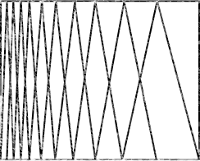
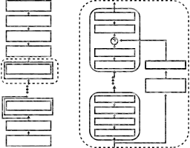
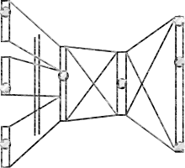
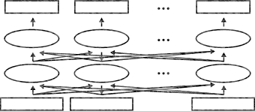

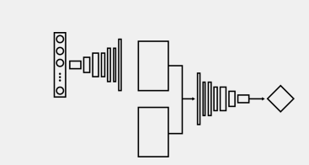
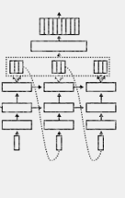
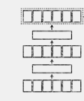
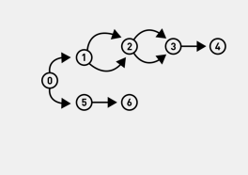

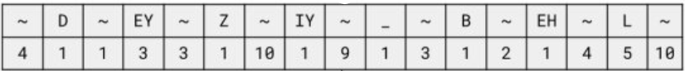
Challenges
New models , domain-specific accuracy, complex pipelines, real-time responses
Automatic Speech Recognition
“What is the weather like
tomorrow in London?”
Audio
Custom Vocabulary
Feature Extraction
Acoustic Model
Decoder or N-gram language model
BERT Punctuation Model
NLU
Dialog Manager
Text-To-Speech
“Expect some clear skies in London tomorrow.”
Audio
Pitch and Duration Predictor
Text Normalization & Preprocessing
Vocoder Model
Spectrogram Generator
Text Encoding
Real-time applications need to deliver latency <300 ms
Notes:
Focus first on the accuracy and latency

Slide 11

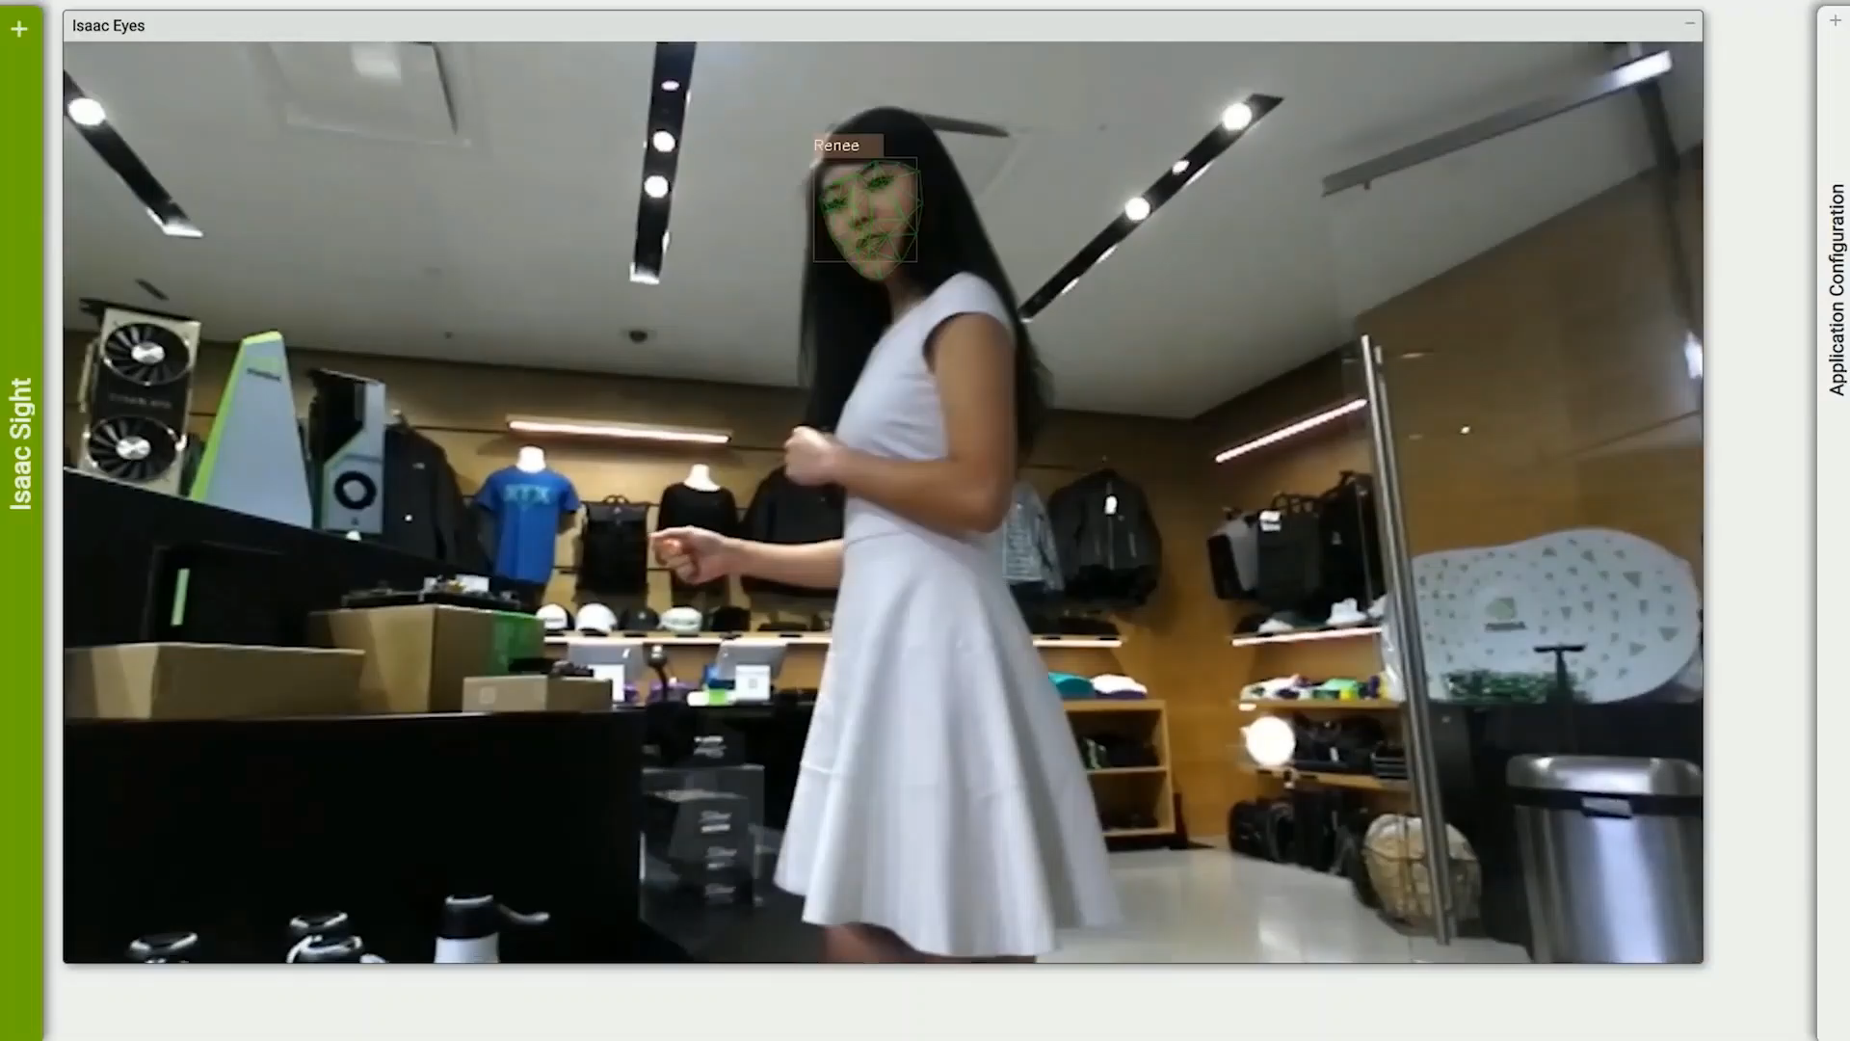
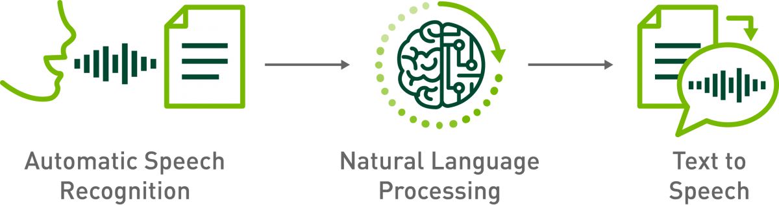
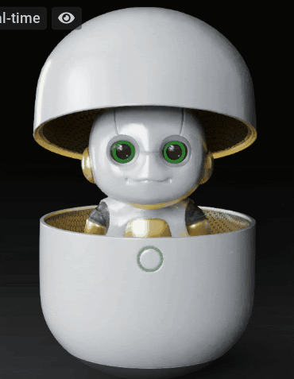


Challenges
New models , domain-specific accuracy, complex pipelines, real-time responses
Intent Classification
Slot Filling
Named Entity Recognition
…
Jetson Nano is 128 CUDA Cores
How many CUDA cores is that?
Digital Avatar
Computer Vision
Notes:
external pieces of information. For instance knowledge database, the weather cast or news, ..
Computer vision, Gaze understanding
So Flexibility is a key for conv AI technologies allowing an easy customization of very heterogeneous pipelines

Slide 12
This is still an oversimplification of the problem

Slide 13
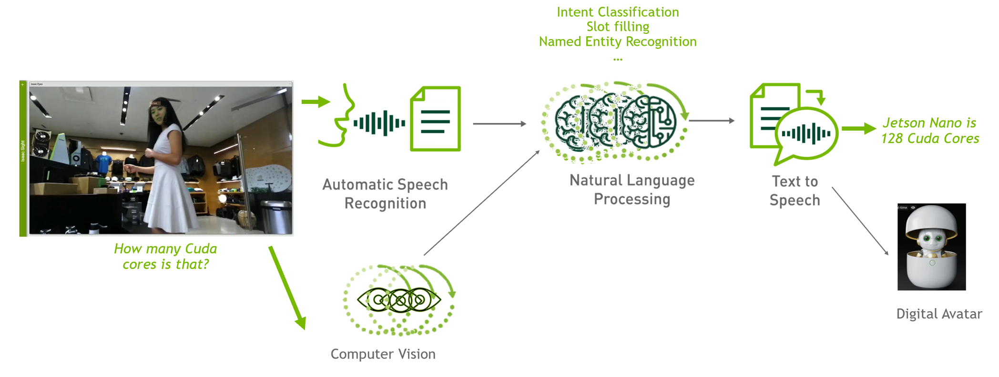
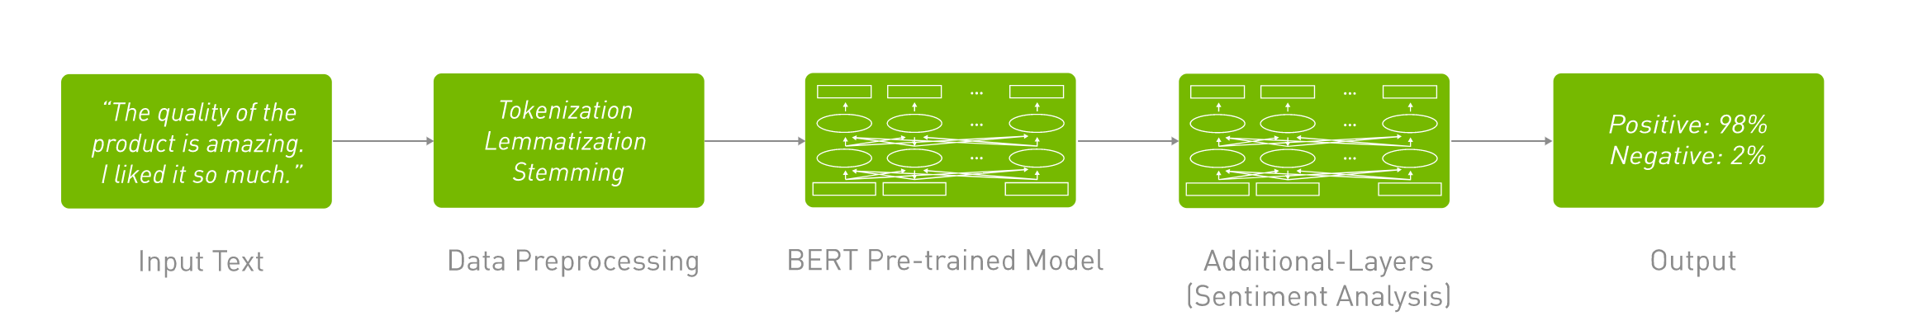
What About Additional Logic?
Notes:
example with 1 sota NLP module for sentiment analysis

Slide 14
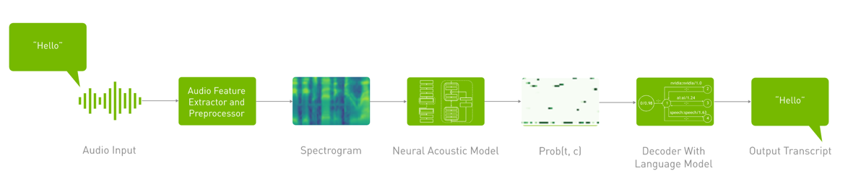
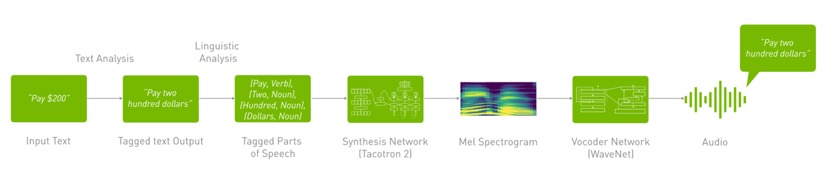
Not Something Unique to NLP
Notes:
And this is the same for the ASR and TTS pipelines

Slide 15
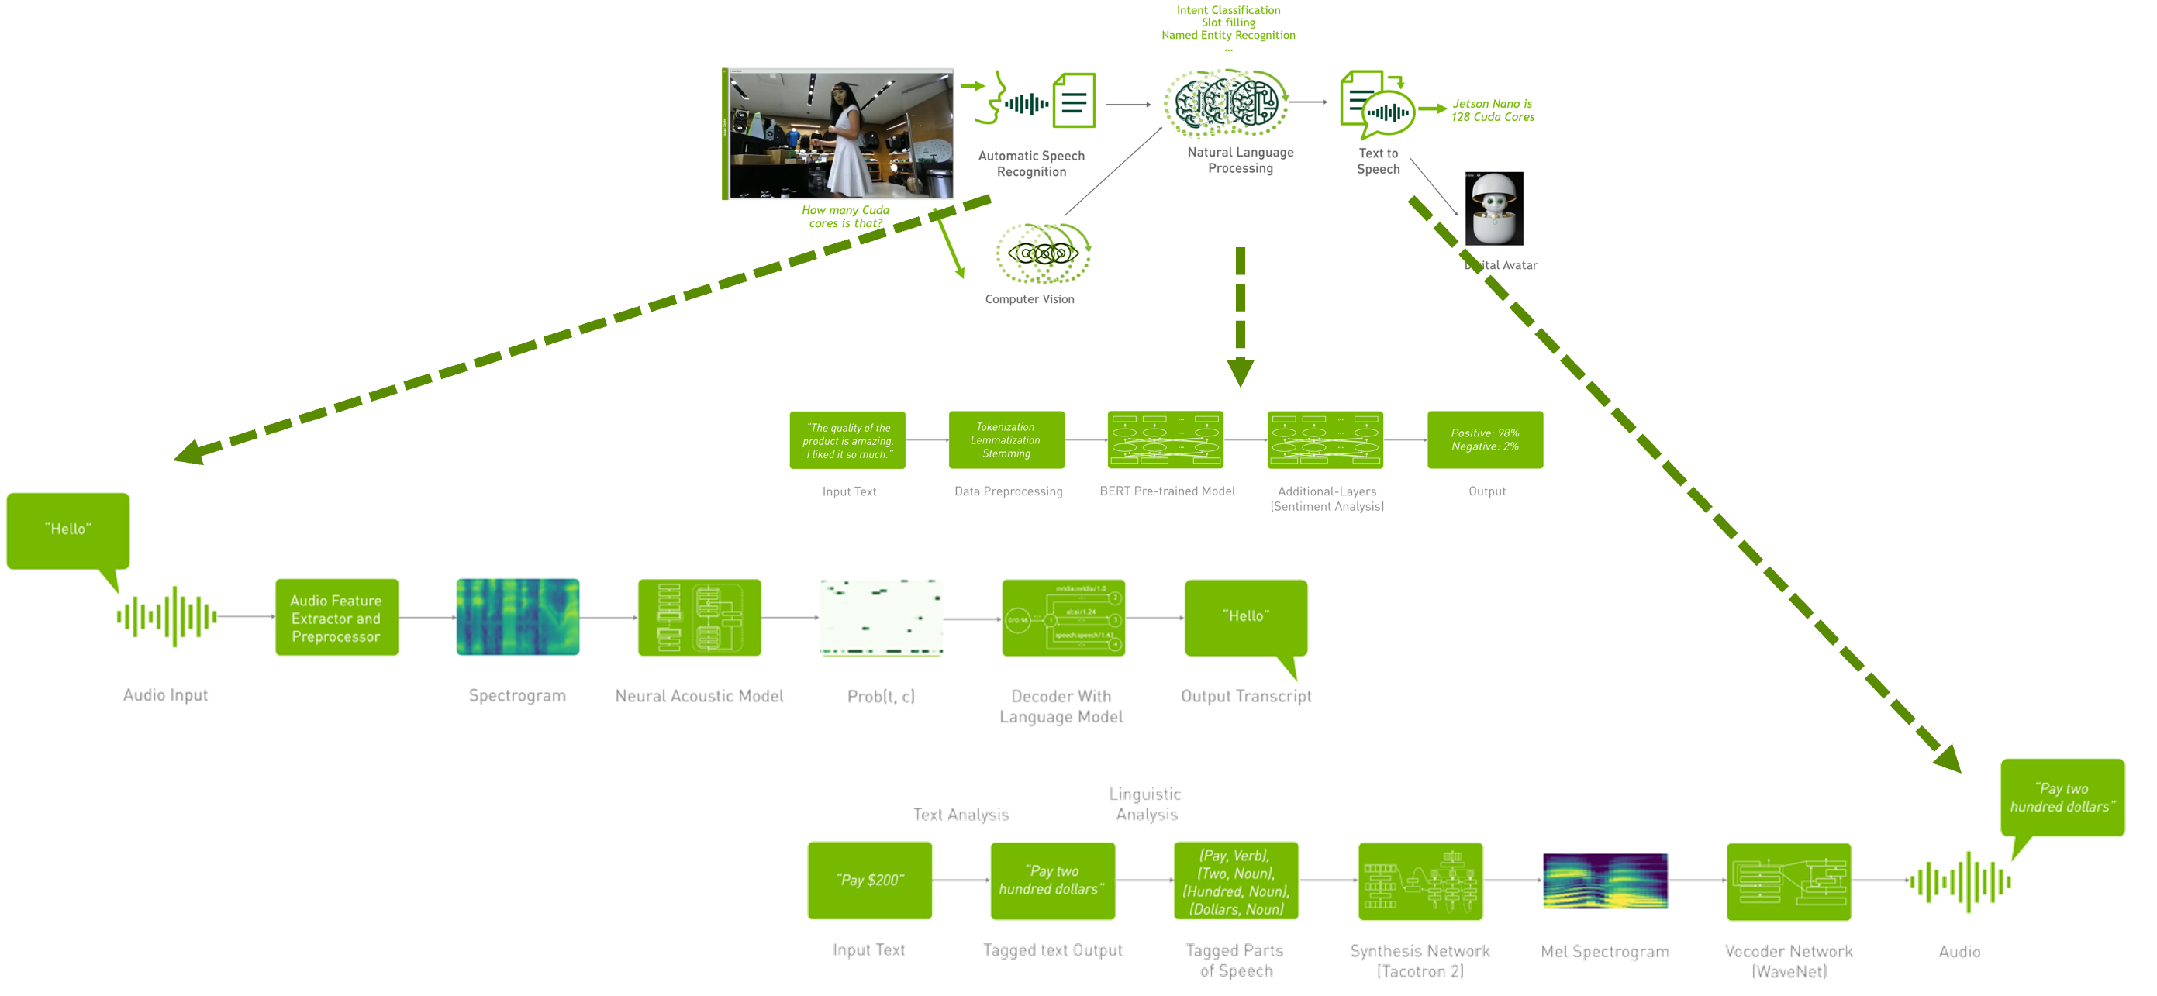
This Was Just a Single Application
Application 1
Notes:
In commercial setting, we usually deploy several versions of the same product across different regions/domain/ languages or event different products.

Slide 16
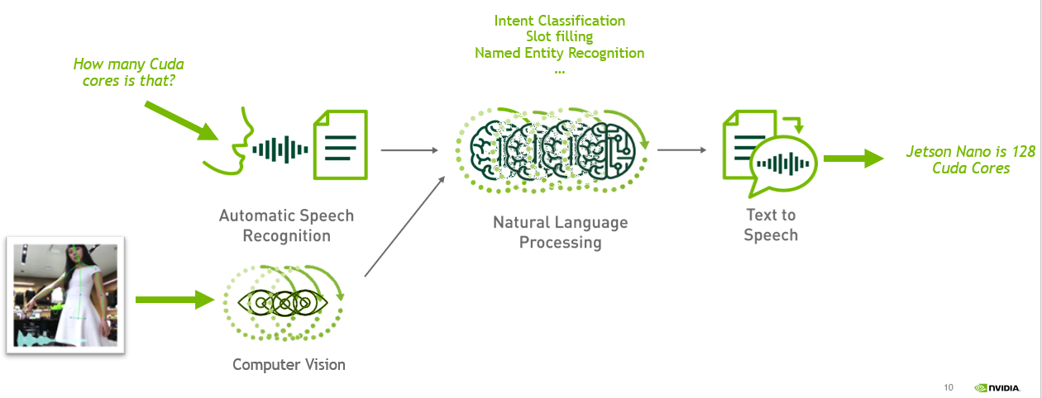

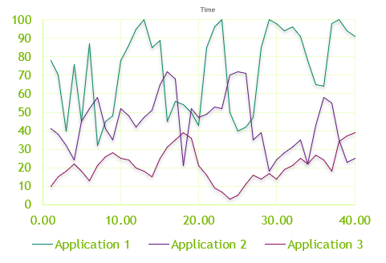
Challenges
Latency, throughput, utilization, capital investment, ongoing costs
Digital Avatar
Application: N
Version: K
Notes:
And each application will have its own request cycle
Adding to that, we need flexible tools allowing to easily monitor applications

Slide 17
Part 1
ASR (Part 1)
Lecture
What is Conversational AI? Complexity of Deploying Conversational AI Applications
Deep Learning Fundamentals
Speech and Text Processing
Automatic Speech Recognition
ASR Tools: Riva, NGC, and NeMo
Lab Overview
Lab
Investigate ASR Pipeline with NeMo and Riva
Notes:
Some fundamentals

Slide 18
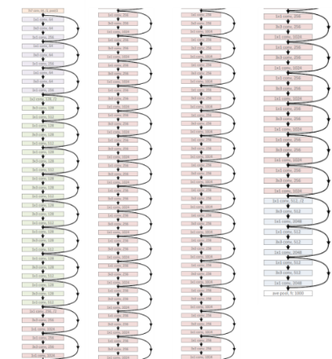
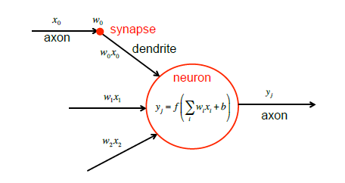
Neural Networks are Not New
They are surprisingly simple as an algorithm
Neural Network - Neuron
Deep Neural Network

Slide 19

Neural Networks
Convolutional and recurrent neural networks
Credit: https://www.asimovinstitute.org/the-neural-network-zoo-2016/
Notes:
Model zoo

Slide 20
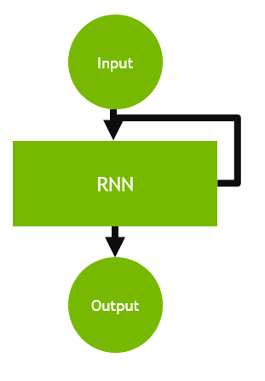
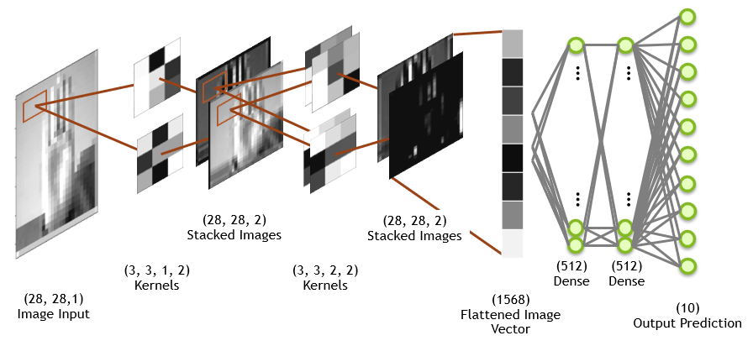
Neural Networks
Convolutional and recurrent neural networks
Credit: https://www.asimovinstitute.org/the-neural-network-zoo-2016/

Slide 21
Neural Networks
Autoregressive and non-autoregressive
Non Autoregressive Models
Autoregressive Models
y1
y2
y3
y4
y5
y6
y1
y2
y3
Neural Network
Neural Network
Neural Network
Neural Network
x1
x2
x3
x4
x5
x6
<>
x1
x2
x3
Predictions of a Non-autoregressive model at the current time step does not depend on the predictions of the previous time-steps
Fast at inference time
Called also parallel
Predictions of an autoregressive model at the current time step depends on the predictions of the previous time-steps
Usually higher accuracy compared to non-autoregressive models due to temporal dependencies
Slow at inference time

Slide 22

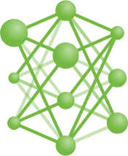
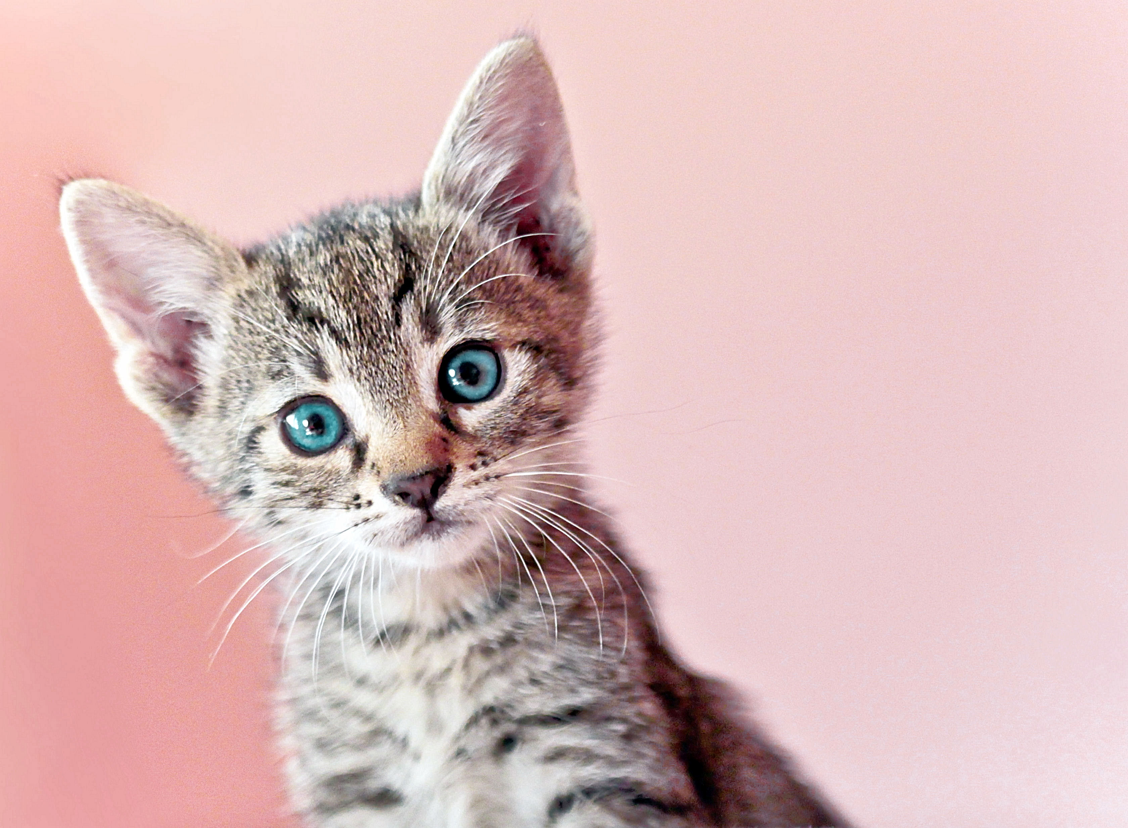
Neural Networks
Supervised, Self-Supervised
Cat
Supervised Training
Self-Supervised Training

Slide 23
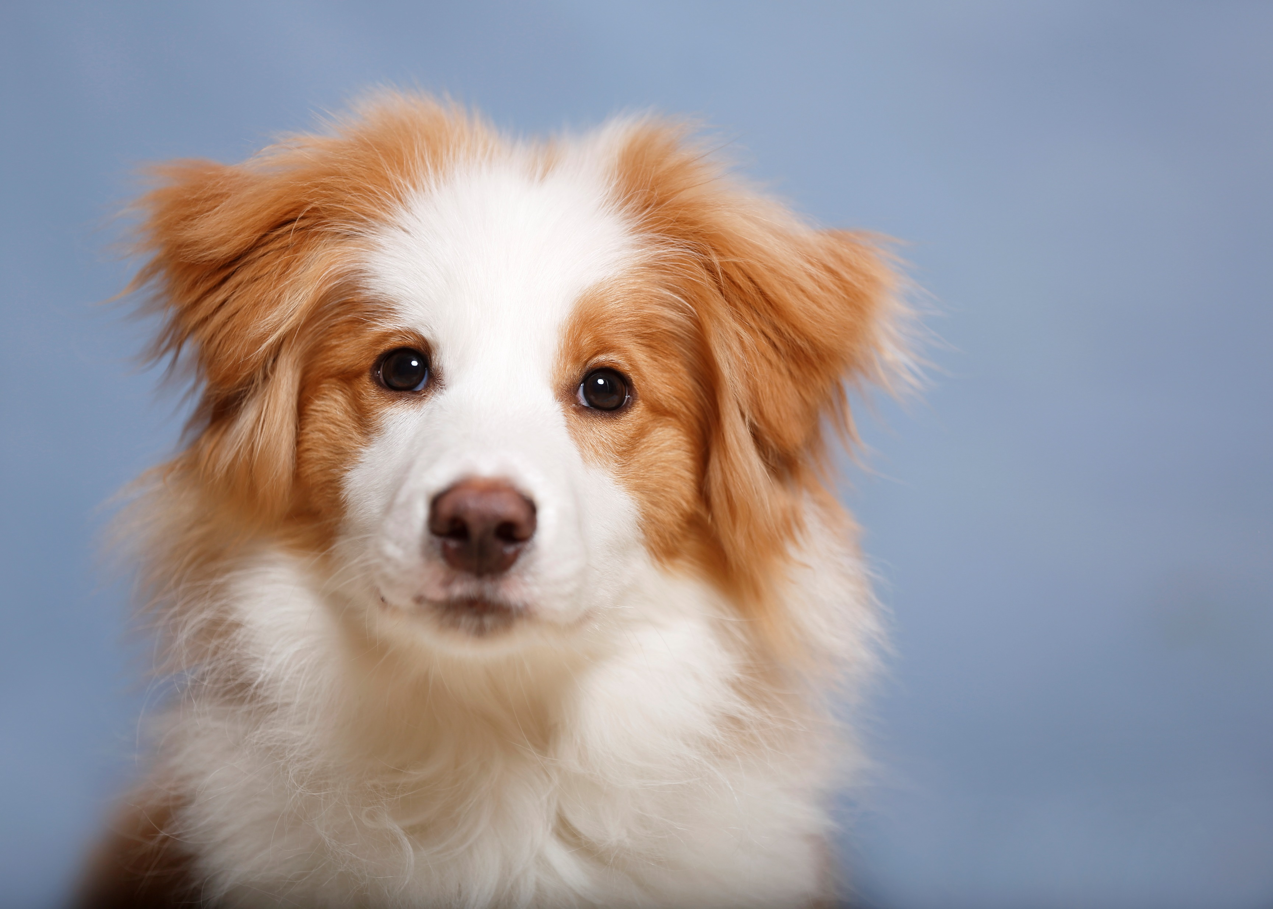
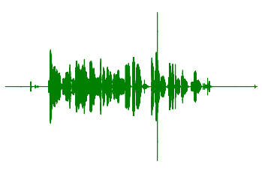
Neural Networks
Self-Supervised
Masking Loss
Contrastive Loss
The cat is playing in the garden
garden
Not same picture
Notes:
with additional similarit distance training

Slide 24
Neural Language Models
Language Model
P(hi) =0.22
P(my) = 0.02
P(name/my) = 0.65
P(is/my) =0.32
P(dana) =0.05
P(the) =0.001
P(data) =0.08
…
Language Model
P(hi my name is dana) ?
Probability of a sentence is decomposed into conditional probabilities of each word given its previous context:
P(hi my name is dana) = p(hi) * p(my/hi) * p(name/hi my) * p(is/hi my name) * p(dana/hi my name is)

Slide 25
Part 1
ASR (Part 1)
Lecture
What is Conversational AI? Complexity of Deploying Conversational AI Applications
Deep Learning Fundamentals
Speech and Text Processing
Automatic Speech Recognition
ASR Tools: Riva, NGC, and NeMo
Lab Overview
Lab
Investigate ASR Pipeline with NeMo and Riva

Slide 26
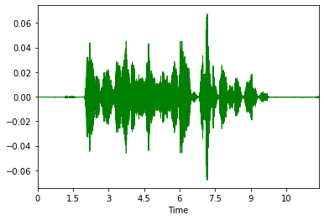
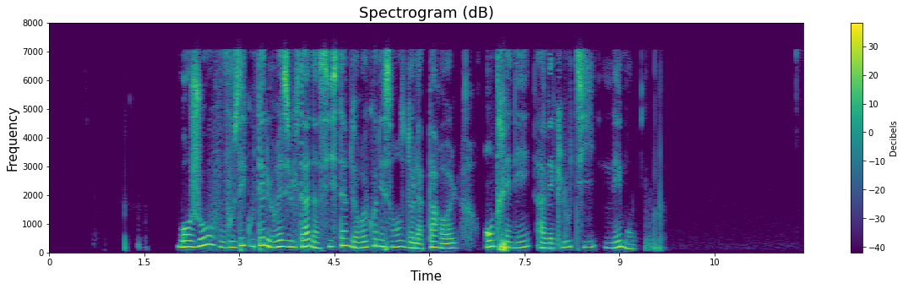
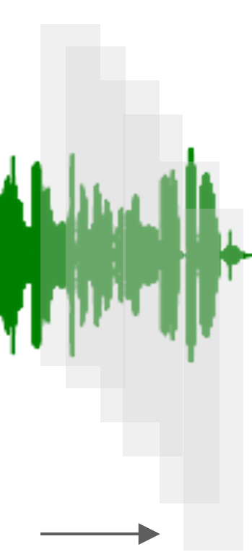
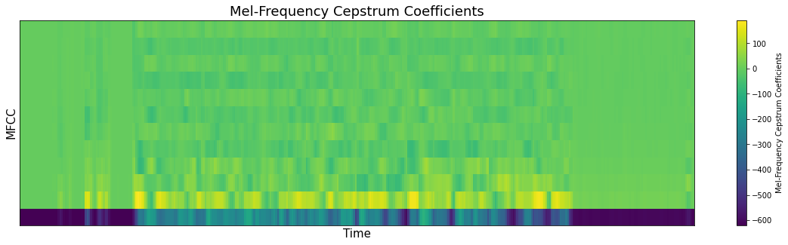
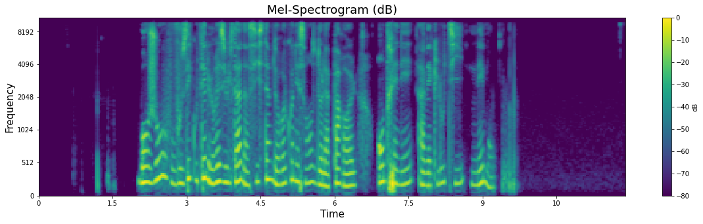
Audio Data
Features Representation
Inverse Discrete Fourier Transform
Windowing 20-25ms, stride 10ms
Discrete Fourier Transform
Log Filter Bank
Discrete Cosine Transform

Slide 27
Text Data
char/graphemes/words → phonemes/tokens
Text | Definition | Examples
Char | Alphabet Characters | a, b, c, d, …n,…
Graphemes | Small unit of a written language | n, nn, kn, gn, pn
Words | Words | Hello, world, ..
Text Representation | Definition | Examples | Standard | Comments
Phonemes | Small unit of spoken sound | /n/ | Grapheme to phonemes | Non Phonetic Languages: Multiple graphemes for a phoneme (eg. “f” "ph") Different pronunciations for same spelling (e.g. “I read book” in present and past)
 |  |  | International Phonetic Alphabet (IPA): 'H', 'E', 'L', 'L', 'O', ' ', 'ˈ', 'w', 'ɝ', 'l', 'd’ ARPABET: HH, AH0, L, OW1, ,W, ER1, L, D
Tokens | Subwords | _use_ful | Tokenizers: Byte-Pair Encoding, WordPiece or SentencPiece | ML Algorithms deal with indexes instead of tokens Tokenizers uses a fixed size of vocabulary Out of Vocabulary OOV: Chars are part of the vocabulary Special token UNK
 |  |  | bert-base-uncased: 'i', 'work', 'for', 'n', '##vid', '##ia’ 1045, 2147, 2005, 1050, 17258, 2401 xlnet-base-cased: '▁', 'i', '▁work', '▁for', '▁', 'n', 'vid', 'ia’ 17, 150, 154, 28, 17, 180, 7791, 780

Slide 28
Part 1
ASR (Part 1)
Lecture
What is Conversational AI? Complexity of Deploying Conversational AI Applications
Deep Learning Fundamentals
Speech and Text Processing
Automatic Speech Recognition
ASR Tools: Riva, NGC, and NeMo
Lab Overview
Lab
Investigate ASR Pipeline with NeMo and Riva
Notes:
Lets now focus on A S R pipline

Slide 29

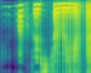
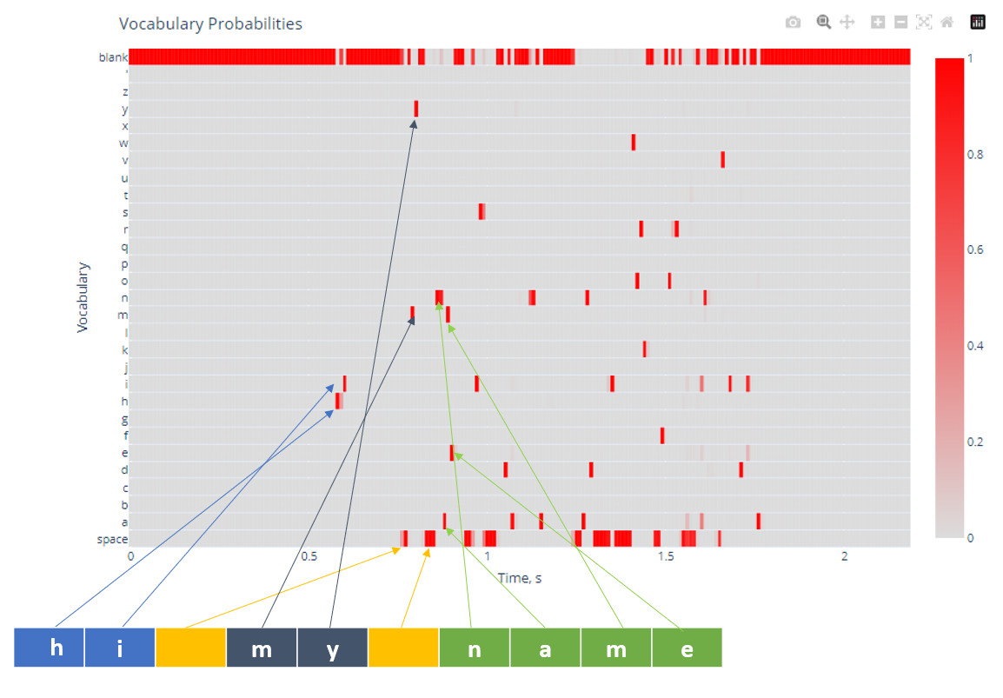
ASR Pipeline
Features Extraction
Acoustic Model
Decoder Rescoring
Post Processing
Punctuation | Capitalization | Normalization
Speech
Text
Input: Speech audio
Output: Spectrogram, MFCC
…
Input: Spectrogram, MFCC
Output: textual features probabilities
Input: Textual features probabilities
Output: Text
Input: Text
Output: Normalized text
i work for in vidia
i work for an vidia
i work for invidia
i work for nvidia
i work for in videa
hi let’s meet at two o'clock => Hi, let’s meet at 2:00

Slide 30
Evaluation Metric

Slide 31
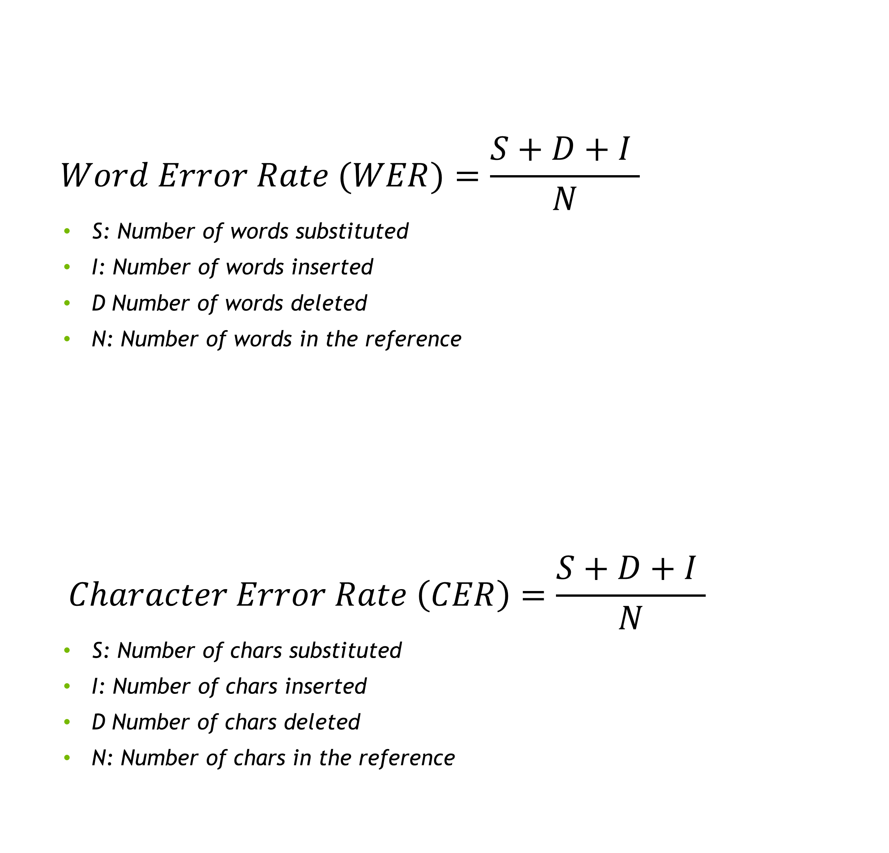
Measuring Success of ASR
WER | CER
$$Word Error Rate (WER)=\frac{S+D+I }{N}$$
S: Number of words substituted
I: Number of words inserted
D Number of words deleted
N: Number of words in the reference
$$Character Error Rate \left(CER\right)=\frac{S+D+I }{N}$$
S: Number of chars substituted
I: Number of chars inserted
D Number of chars deleted
N: Number of chars in the reference
Reference | the cat sat on the mat
Transcription | the cats at on mat yeah
WER=0.66 | D=1, S=2, I=1, N=6
Reference | 't', 'h', 'e', ' ', 'c', 'a', 't', ' ', ‘s’, 'a', 't', ' ', 'o', 'n', ' ', 't', 'h', 'e', ' ', 'm', 'a', 't'
Transcription | 't', 'h', 'e', ' ', 'c', 'a', 't', ' ', ‘s’, 'a', 't', ' ', 'o', 'n', ' ‘, ‘n', 'a', 't'
CER=0.2272 | D=4, S=1, I=0, N=22
Notes:
Basically for WER. We compare the transcriptions with the output of the system and compute 3 type of errors
Insertion
Deletions
Substitutions

Slide 32
Loss Function
Notes:
How about AM loss functions?

Slide 33
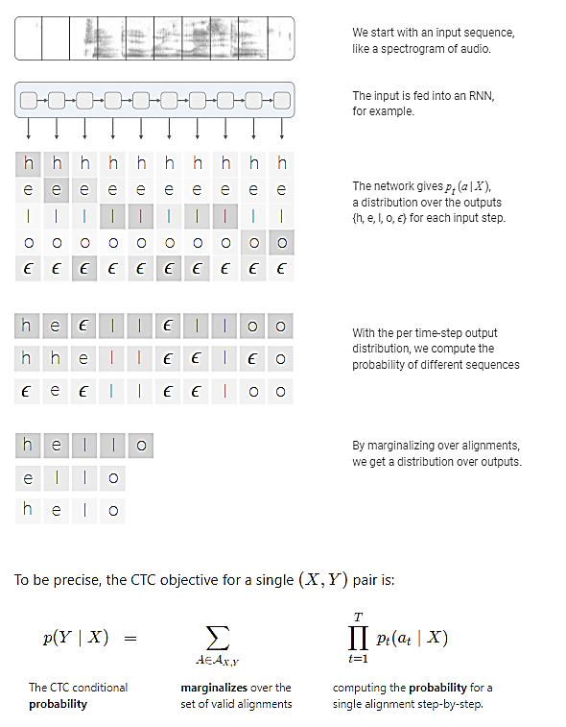
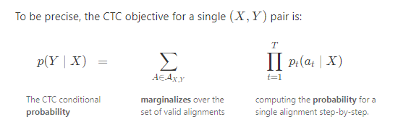
Acoustic Models
Connectionist Temporal Classification (CTC)
https://distill.pub/2017/ctc/
Notes:
To train ASR models, you need audio and transcriptions right.
Connectionist Temporal Classification loss function CTC.
It does not require an alignment between the input and the output
To get the probability of an output given an input, CTC, Compute the probability of different sequences, removes the blank and repetitions
And sums over the probability of all possible alignments.

Slide 34
Acoustic Models

Slide 35
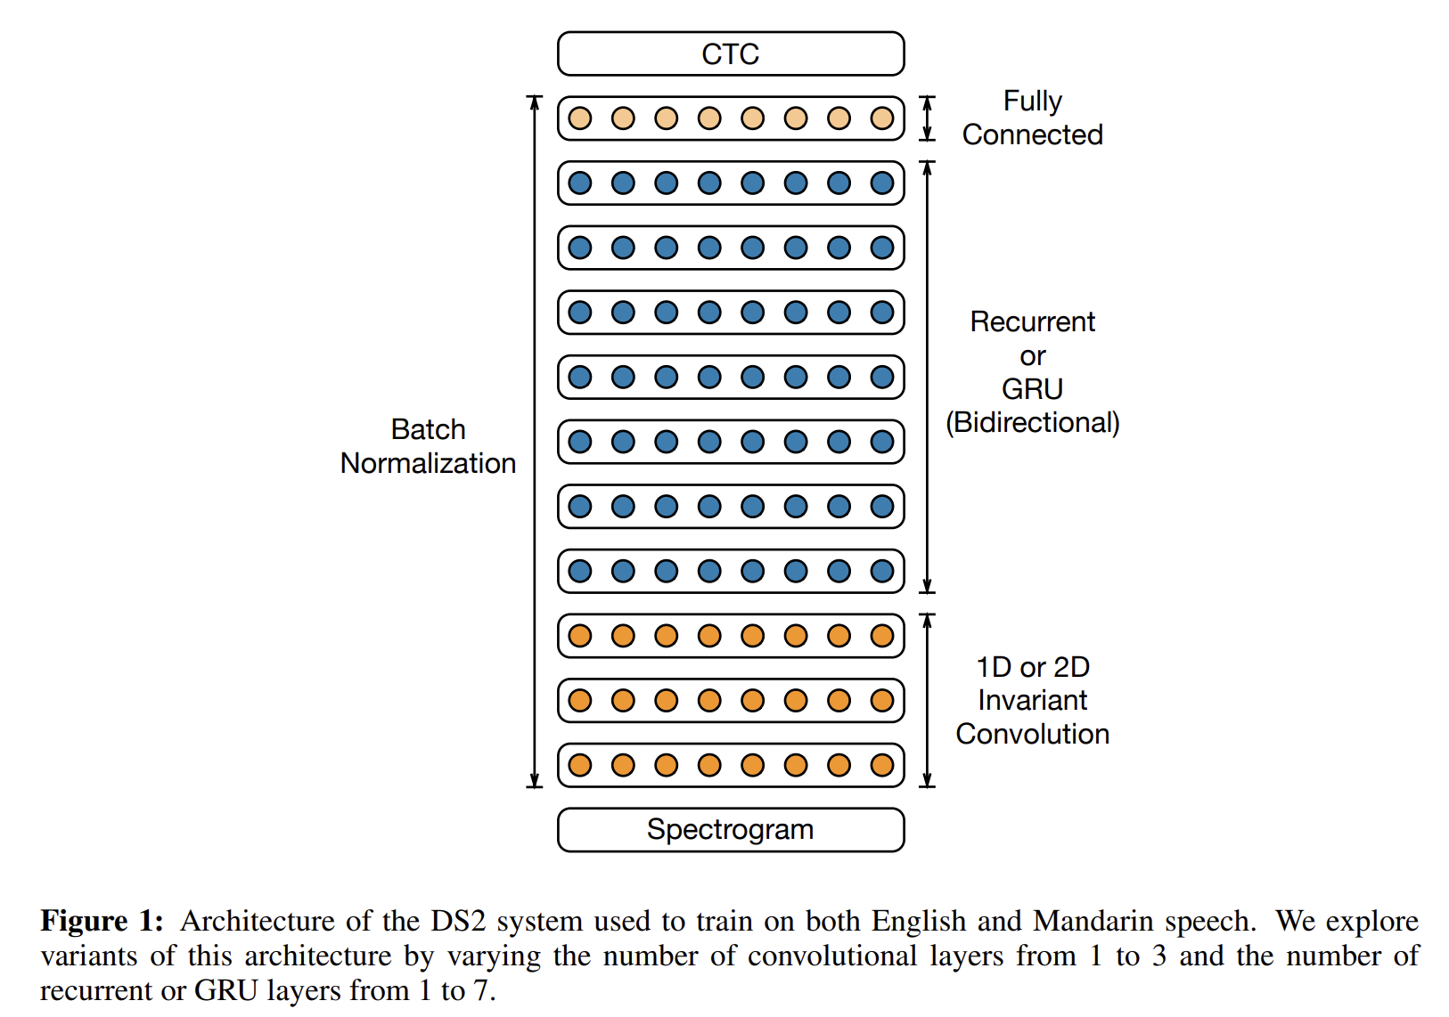
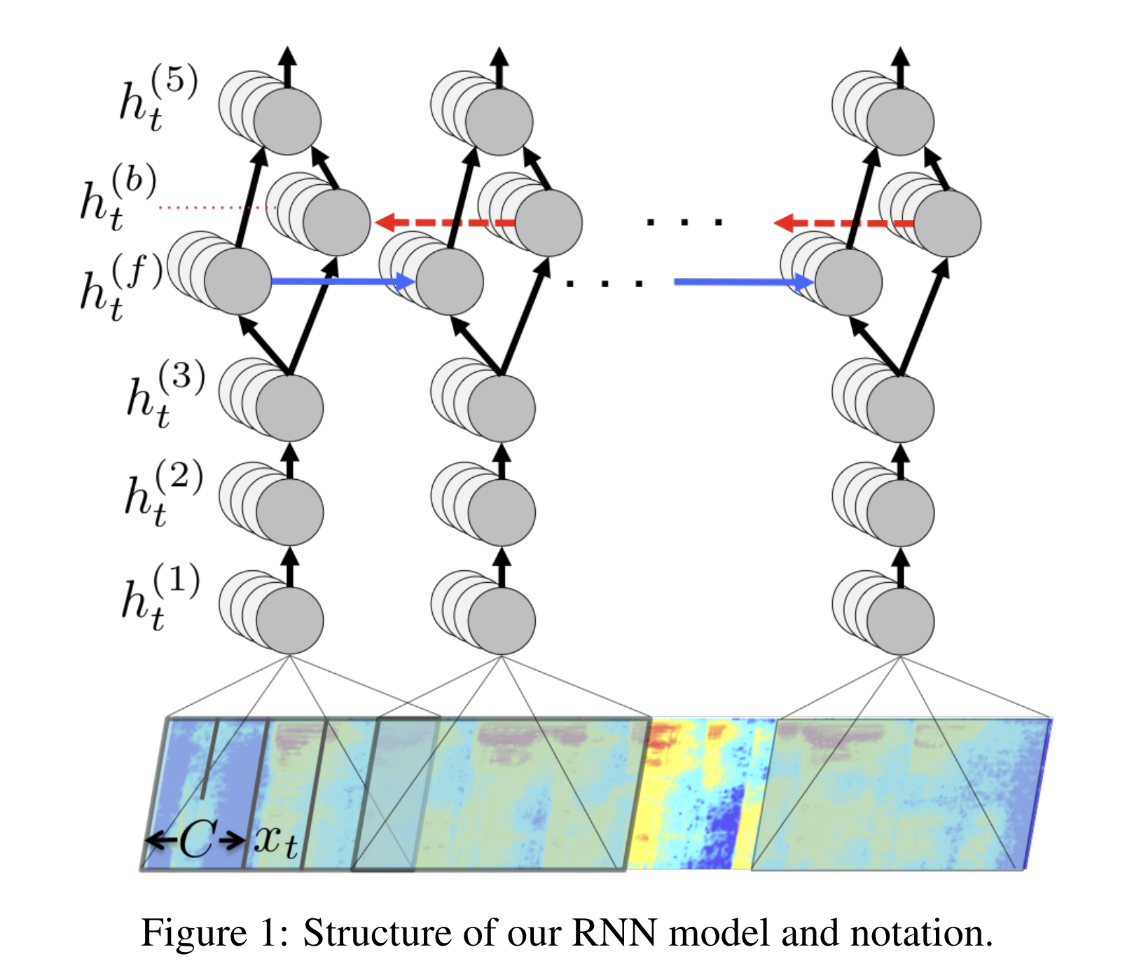
Acoustic Models
RNN-based approaches: DeepSpeech and DeepSpeech2
Large Model: 100M parameters
Large Dataset: 11K hours
RNN-based approaches are computationally intense
Compute optimization: All reduce implementation, CTC loss compute on GPU
Awni Hannun , Carl Case, Jared Casper, Bryan Catanzaro, Greg Diamos, Erich Elsen, Ryan Prenger, Sanjeev Satheesh, Shubho Sengupta, Adam Coates, Andrew Y. Ng .Deep Speech: Scaling up end-to-end speech recognition. 2014
Notes:
Deepspeeh and deepspeech2
This is from Baidu
Languages: English mandarin
Large Model: 100M parameters
Input: Spectrograms
Architecture: Bi directional RNN with CTC loss.
character-level transcriptions

Slide 36
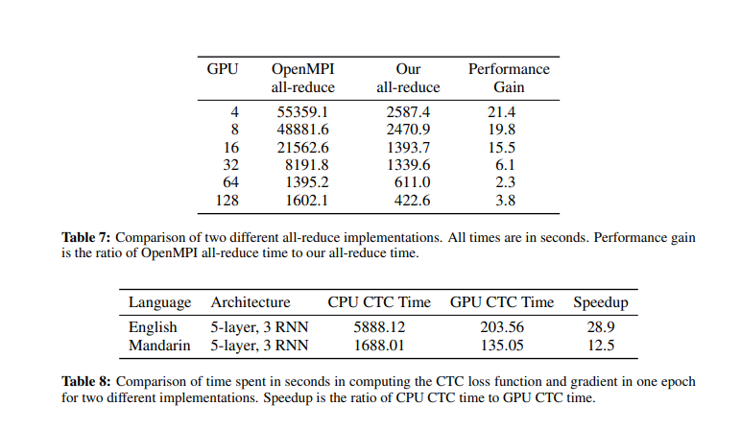
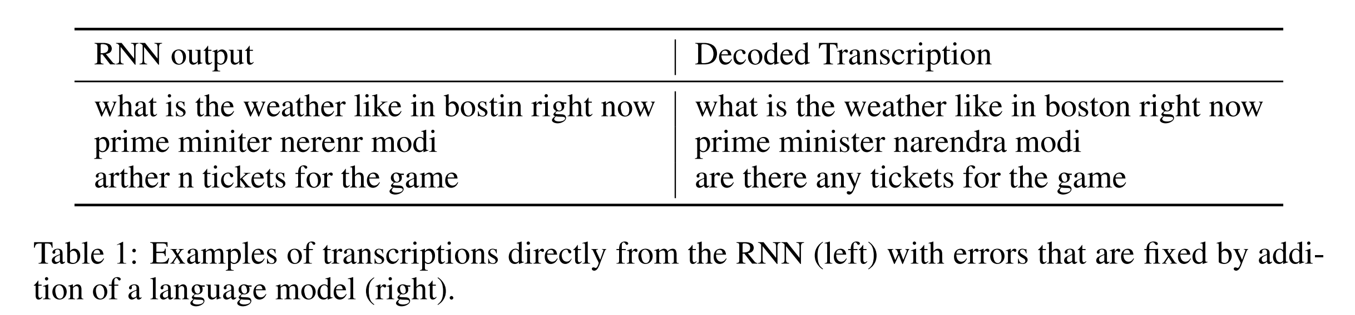
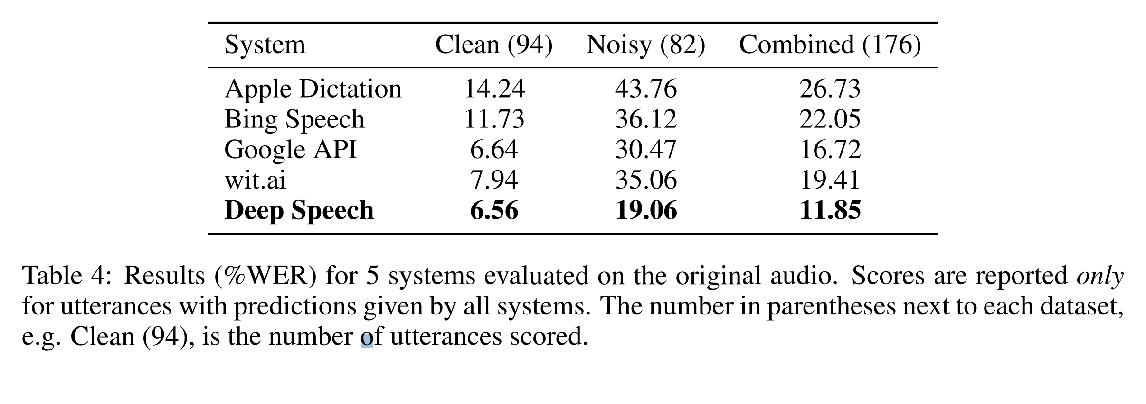
Acoustic Models
RNN-based approaches: DeepSpeech and DeepSpeech2
Large Model: 100M parameters
Large Dataset: 11K hours
RNN-based approaches are computationally intense
Compute optimization: All reduce implementation, CTC loss compute on GPU
Awni Hannun , Carl Case, Jared Casper, Bryan Catanzaro, Greg Diamos, Erich Elsen, Ryan Prenger, Sanjeev Satheesh, Shubho Sengupta, Adam Coates, Andrew Y. Ng .Deep Speech: Scaling up end-to-end speech recognition. 2014
Notes:
In DS2, authors worked on the implementation side where to optimize the compute at training and inference
second: a Special All reduce implementation
First: CTC loss compute ported on the GPU

Slide 37
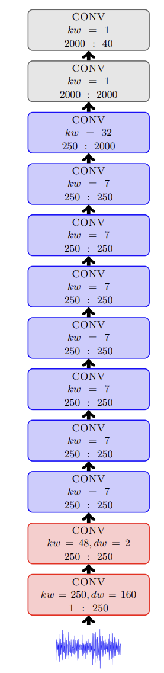
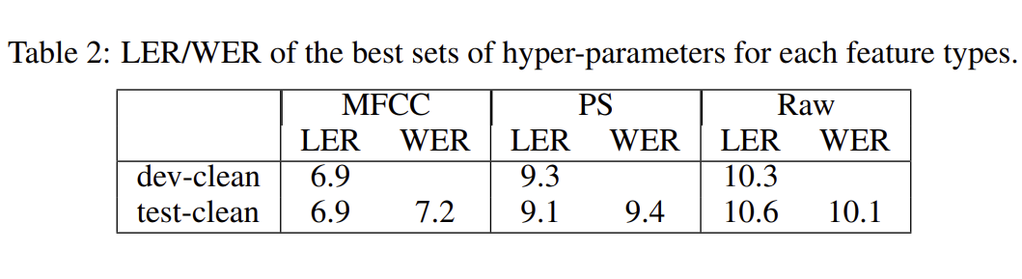
Acoustic Models
Simplifying with 1D convolutional layers: Wave2Letter
Ronan Collobert and Christian Puhrsch and Gabriel Synnaeve. Wav2Letter: an End-to-End ConvNet-based Speech Recognition System. 2016
https://nvidia.github.io/OpenSeq2Seq/html/speech-recognition/wave2letter.html​
Notes:
Wave2letter from Facebook (Meta)
3 type of inputs: raw speech, spectrum and MFCC. Best results were obtained by MFCC
Architecture: They suggested an architecture with No RNN. 1D convolutional layers, 208M parameters
Output: Graphemes (char)
Adding a Greedy or beam-search decoder
Wave2Letter++: is an nvidia implementation with 17 1D convolutional layers + 2 FC layers, Output: Graphemes (char)

Slide 38
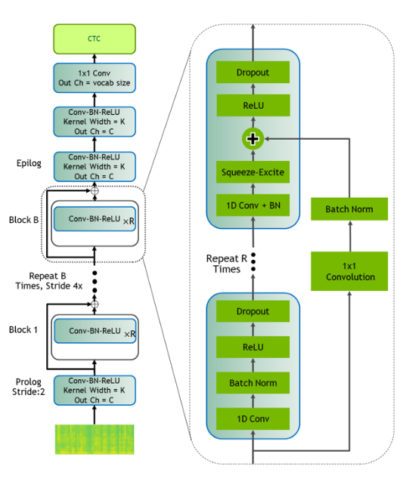
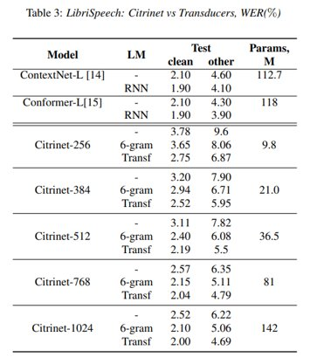
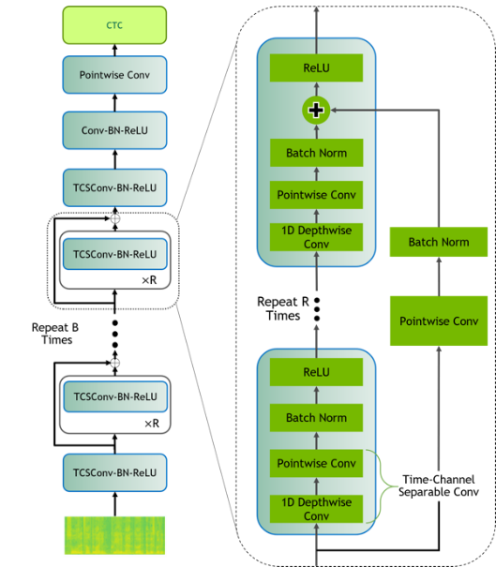
Acoustic Models
QuartzNet
Citrinet
Kriman, S., Beliaev, S., Ginsburg, B., Huang, J., Kuchaiev, O., Lavrukhin, V., ... & Zhang, Y. (2020, May). QuartzNet: Deep automatic speech recognition with 1d time-channel separable convolutions. In ICASSP 2020-2020 IEEE International Conference on Acoustics, Speech and Signal Processing (ICASSP) (pp. 6124-6128). IEEE.
Notes:
Some NVIDIA’s Convolutional Models are Jasper, QuartzNet and Citrinet.
QuartzNet’s : replaced the conventional convolutions with Channel Separable Convolution to reduce the number of parameters
Quartzenet:19M parameters
Citrinet is a version of QuartzNet that extends
- use subword encoding (via Word Piece tokenization) instead of char
Squeeze-and-Excitation mechanism (weights the importance of each channel when computing the output of the conv )
Citrinet-1024 (around 142M parameters) and smaller variant Citrinet-256 (around 9.8M parameters).

Slide 39
Channel Separable Convolution
10x10x3
4 x 10x10x1
4 x 3x3x3
10x10x3
3 x 3x3x1
10x10x3
4 x 10x10x1
4x 1x1x3
Notes:
Classic conv = Depth-whise + pointwise

Slide 40
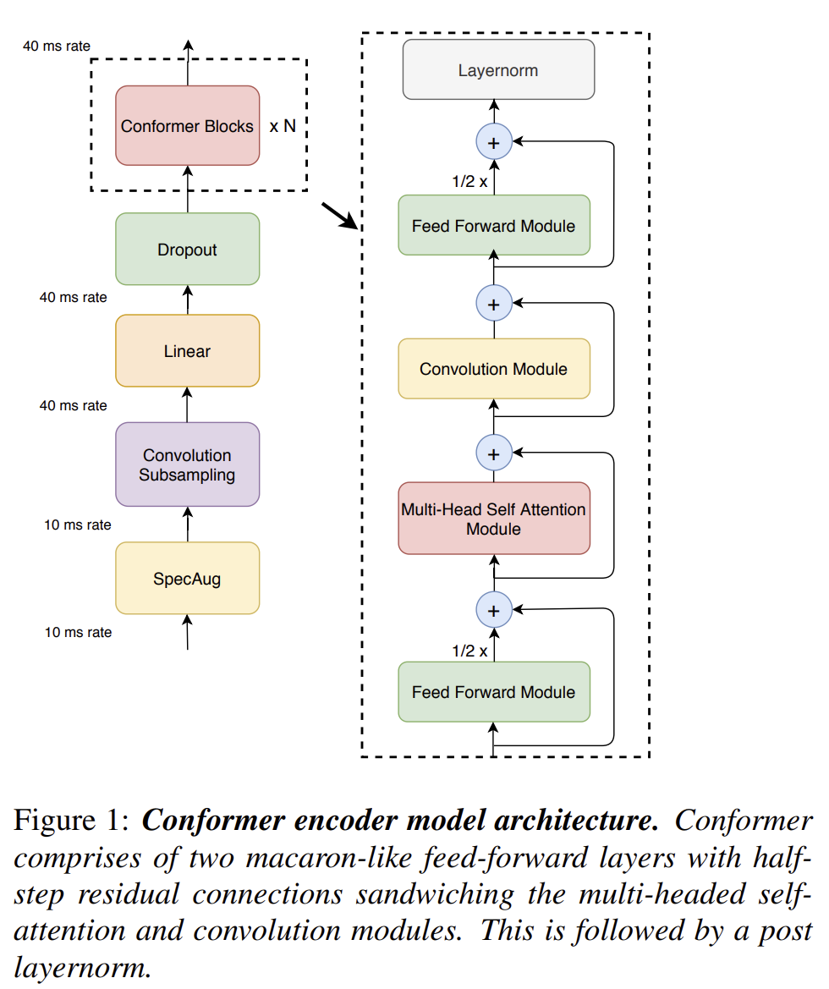


Acoustic Models
Conformer and Conformer-CTC
LSTM-layer decoder in all our models.
Notes:
Conformer: Paper from Google
Combines CNN and transformer models
RNN Transducer models has three modules that are trained jointly: The Encoder, Predictor, and Joint network.
- Encoder models the acoustic features of speech
- Predictor (decoder) acts as a Language Model to learn language information from the training data.
- Joint network takes in the predictions from the Encoder and Predictor to produce a label (proba over the vocab)

Slide 41
Acoustic Models
Conformer-CTC
CTC loss/decoding instead of Transducer
Notes:
Conformer-CTC is a CTC-based variant of the Conformer
Making it non-autoregressive model.
LSTM decoder is replaced by a linear decoder on the top of the encoder.
Conformer-CTC (around 120M)

Slide 42




Acoustic Models
Transfer learning
“Transfer learning is a process of transferring learned features from one model to another”
Key Benefits
$
Less Data Required to Train Accurately
Reduce Training Time and Cost
https://blogs.nvidia.com/blog/2019/02/07/what-is-transfer-learning/

Slide 43



Acoustic Models
Transfer learning
Language 1 Vocab
Language 2 Vocab
Transfer
Transfer
Transfer
Language 1 ASR Model
Language 2 ASR Model
Jocelyn Huang, Oleksii Kuchaiev, Patrick O'Neill, Vitaly Lavrukhin, Jason Li, Adriana Flores, Georg Kucsko, Boris Ginsburg
Cross-Language Transfer Learning, Continuous Learning, and Domain Adaptation for End-to-End Automatic Speech Recognition, 2020

Slide 44

Acoustic Models
Wave2vec 2.0
Alexei Baevski Henry Zhou Abdelrahman Mohamed Michael Auli. wav2vec 2.0: A Framework for Self-Supervised Learning of Speech Representations. 2020
Notes:
Wav2vec, From FB (Meta)
2 training phases
Phase1: Self supervised training to learn good speech features representation
Phase2: Finetuning for ASR using a linear projection layer.

Slide 45

Acoustic Models
Wave2vec 2.0
Alexei Baevski Henry Zhou Abdelrahman Mohamed Michael Auli. wav2vec 2.0: A Framework for Self-Supervised Learning of Speech Representations. 2020
Notes:
Architecture:
Input: raw waveform
Convolutional layers: to get latent representation Z
Transformer layers: contextualised representation C
Contrastive Loss: comparing a contextualized representation from the transformer layers and a quantized representation of the speech z

Slide 46

Acoustic Models
Wave2vec 2.0
Alexei Baevski Henry Zhou Abdelrahman Mohamed Michael Auli. wav2vec 2.0: A Framework for Self-Supervised Learning of Speech Representations. 2020
Notes:
Architecture:
Input: raw waveform
Convolutional layers to get latent representation Z
Transformer layers, that creates contextualised representation C
A linear projection layer to get the labels

Slide 47
Acoustic Models
Wave2vec 2.0
“This demonstrates the feasibility of speech recognition with limited amounts of labeled data.”
“When lowering the amount of labeled data to one hour, wav2vec 2.0 outperforms the previous state of the art on the 100 hour subset while using 100 times less labeled data. “
“ Using just ten minutes of labeled data and pre-training on 53k hours of unlabeled data still achieves 4.8/8.2 WER.
Alexei Baevski Henry Zhou Abdelrahman Mohamed Michael Auli. wav2vec 2.0: A Framework for Self-Supervised Learning of Speech Representations. 2020
Notes:
By using SSL, they demonstrated the feasibility of training ASR with limited data

Slide 48





Multilingual vs Code-Switched Acoustic Models
hi
cao
hola
is
bonjour
dana
Multilingual AM
Code-Switched AM
Tokens IDs
0->3071
Tokens IDs
0->1023
1024->2047
2048->3071
Multilingual Tokenizer
Lang1 Tokenizer
Lang2 Tokenizer
Lang3 Tokenizer
Input Speech
Input transcriptions
Input Speech
Input transcriptions
{"audio_filepath": "data1.wav", "duration": 3.04, "text": “once upon a time ", "lang": "en"}
{"audio_filepath": "data2.wav", "duration": 5.33, "text": “Bonjour, je souhaite connaitre la facture", "lang": “fr"}
….
{"audio_filepath": "/data2.wav", "duration": 17.32425, "text": [{"lang": "en", "str": "the mentality is that of a slave-owning community with a mutilated multitude of men tied to its commercial and political treadmill "}, {"lang": "es", "str": "y este "}]}
….
https://developer.nvidia.com/blog/multilingual-and-code-switched-automatic-speech-recognition-with-nvidia-nemo/
Notes:
Multilingual models can have their advantages:
Serve several languages with 1 model
In the context of mixing different languages in the same sentence.
Code-switching refers to changing between different languages during a conversation.
Any AM we have seen before can be trained in multilingual context.
pure multilingual training and cod switching differ on the data preparation and tokenization.

Slide 49

Multilingual Acoustic Models
Whisper
Alec Radford, Jong Wook Kim, Tao Xu, Greg Brockman, Christine McLeavey., Ilya Sutskever. Robust Speech Recognition via Large-Scale Weak Supervision.2022
Notes:
Whisper model from OpenAI!
Multilinguality ( almost 100 languages)
It is a encoder decoder transformer model (sequence 2 sequence)
Input: spectrogram
Encoder: transformer
Decoder: transformer conditioned on the encoder hidden states and previously predicted tokens
Output trained for next token prediction
Several versions: 39 M to 1.5B
Data: 680,000 hours of audio and the corresponding transcripts collected from the internet.
65% English-language audio and matched English transcripts,
17% non-English audio and the corresponding transcript.
18% represents non-English audio to English transcripts
multitask training format taking advantage of available labels
improved robustness to accents, background noise, technical language, as well as zero shot translation from multiple languages into English; and that accuracy on speech recognition and translation is near the state-of-the-art level.
Limitations:
- hallucination (outputting something completely different from the speech). This might be due to the loss that is combining audio transcription prediction and next word prediction in general.
- autoregressive

Slide 50
Acoustic Models
Recap
Models | Tasks | Approach | Training | Comments
DeepSpeech | ASR | RNN-based + CTC | Supervised | Autoregressive
DeepSpeech2 | ASR | RNN-based + CTC | Supervised | Autoregressive
Wave2vec 2.0 |  | Transformer + Convolutional | Self-Supervised + Supervised finetuning | Non Autoregressive
Citrinet | ASR | Convolutional + CTC | Supervised | Non Autoregressive
Conformer-CTC | ASR | Transformer + Convolutional + CTC | Supervised | Non Autoregressive
Conformer-RNNTransducer | ASR | Transformer + Convolutional + LSTM | Supervised | Autoregressive
Wave2Letter | ASR | Convolutional + CTC | Supervised | Non Autoregressive
Whisper | Multilingual Multitask | Transformer + Convolutional | Supervised | Autoregressive

Slide 51
ASR Pipeline
Features Extraction
Acoustic Model
Decoder Rescoring
Post Processing
Punctuation | Capitalization | Normalization
Speech
Text
Input: Speech audio
Output: Spectrogram, MFCC
…
Input: Spectrogram, MFCC
Output: textual features probabilities
Input: Textual features probabilities
Output: Text
Input: Text
Output: Normalized text
i work for in vidia
i work for an vidia
i work for invidia
i work for nvidia
i work for in videa
hi let’s meet at two o'clock => Hi, let’s meet at 2:00

Slide 52


Decoder Rescoring
Greedy decoder | beam search decoder
dana
Greedy Decoder
Beam search decoder
Choose the k (beam width) best hypotheses
Score the V possible extensions per hypothesis
Choose the best k
danger
from
my
is
dana
may
feels
name
data
blank
the
nail
data
from
start
last
hi
my
hello
may
name
is
the
nail
feels
last
danger
hi my name feels data | score 0.78
hi my name is dana | score = 0.72
Hi my nail is data
P(hi my name is dana) = p(hi) * p(my/hi) * p(name/hi my) * p(is/hi my name) * p(dana/hi my name is)
https://medium.com/@jessica_lopez/understanding-greedy-search-and-beam-search-98c1e3cd821d

Slide 53
Decoder Rescoring
Beam search decoder with a language model
Language Model: The probability of a word depends its previous words.
P(hi my name is dana) = p(hi) * p(my/hi) * p(name/hi my) * p(is/hi my name) * p(dana/hi my name is)
N-gram LM: The probability of a word depends on a fixed N previous words.
Example 2-gram: P(hi my name is dana) = p(hi) * p(my/hi) * p(name/hi my) * p(is/hi my name) * p(dana/hi my name is)
final_score = acoustic_score + α lm_score + β seq_length
hi my name feels data | score 0.66
hi my name is dana | score = 0.79
https://medium.com/@jessica_lopez/understanding-greedy-search-and-beam-search-98c1e3cd821d

Slide 54
ASR Pipeline
Features Extraction
Acoustic Model
Decoder Rescoring
Post Processing
Punctuation | Capitalization | Normalization
Speech
Text
Input: Speech audio
Output: Spectrogram, MFCC
…
Input: Spectrogram, MFCC
Output: textual features probabilities
Input: Textual features probabilities
Output: Text
Input: Text
Output: Normalized text
i work for in vidia
i work for an vidia
i work for invidia
i work for nvidia
i work for in videa
hi let’s meet at two o'clock => Hi, let’s meet at 2:00

Slide 55


Post Processing
Punctuation, Capitalization

Slide 56


Post Processing
Normalization: Grammar Rules
Normalization: Grammar Rules
Weighted finite-state transducer (WFST) grammars
Yang Zhang , Evelina Bakhturina, Kyle Gorman , Boris Ginsburg. NeMo Inverse Text Normalization: From Development To Production. 2021

Slide 57
Other Speech Tasks

Slide 58

Speech Tasks
Speech Command Recognition The task of classifying an input audio pattern into a discrete set of classes.
E.g.: Yes, No, ”Go”, ”Stop”, ”Left”, ”Down”
Audio Sentiment Classification Extends the conventional text-based sentiment
analysis to depend on the acoustic features
extracted from speech.
Voice Activity Detection (VAD) The task of predicting which parts of input audio contain speech versus background noise.
Speaker Diarization
Group same speakers
Spoken Language Identification (LangID) The task of recognizing the language of the spoken utterance automatically.

Slide 59
Part 1
ASR (Part 1)
Lecture
What is Conversational AI? Complexity of Deploying Conversational AI Applications
Deep Learning Fundamentals
Speech and Text Processing
Automatic Speech Recognition
ASR Tools: Riva, NGC, and NeMo
Lab Overview
Lab
Investigate ASR Pipeline with NeMo and Riva

Slide 60

What is NeMo?
Toolkit to build state-of-the-art conversational AI models
DL-Based Speech & Language Understanding Models
Include Semantic Checking for Correct-by-Construction Architectures
Open-Sourced
Integrated with PyTorch & PyTorch Lightning
Easy-to-Use APIs
Optimized Training Performance
100+ Pre-Trained GPU-Optimized Checkpoints
Scale to 1000s of NVIDIA GPUs
https://ngc.nvidia.com/catalog/containers/nvidia:nemo
https://github.com/NVIDIA/NeMo

Slide 61




NVIDIA Riva
Fully customizable, GPU-accelerated SDK for real-time Speech AI
NGC
Out-Of-The-Box
RIVA SKILLS: ASR & TTS
Accurate Transcriptions
RETRAIN
Refine Model
Build Your Own Model
Domain Specific
Speech
SOTA Pre-Trained Models
Train for Any
Domain and Language
Fully Customizable for the Best Possible Accuracy
GPU-Accelerated, Real-Time
Scale to Hundreds of Thousands of Users
On-Prem, in Any Cloud, at the Edge, or Embedded
SOTA – State-Of-The-Art | ASR – Automatic Speech Recognition | TTS – Text-To-Speech

Slide 62















NVIDIA Riva Automatic Speech Recognition
The best possible ASR with SOTA deep learning
Accurate ASR with SOTA* models trained for 1M+ hrs on 70K hrs of speech
Support for:
Languages: English, Spanish, Mandarin, Hindi, Russian, Korean, German, French, Arabic, Italian, Japanese, Brazilian-Portuguese, European-Spanish
2X accuracy improvement with customizations for:
Industry specific jargon
Accents & dialects
Noisy environments
Real-time performance far below 300ms for interactive speech apps
High scale of 100s thousands of concurrent streams
Runs anywhere: all clouds, on-premises, at the edge, embedded
Applications
Contact Centers
Consumer Applications
Video Conferencing
CRISP / Service Provider
Media & Entertainment
Transportation
Healthcare
Energy
Finance
Retail
Education
Telecom
RIVA ASR
Triton
TensorRT
All Clouds, On-Premises, Edge, & Embedded
Systems
Cloud
NVIDIA DGX
NVIDIA EGX
SOTA – State-Of-The-Art | ASR – Automatic Speech Recognition | TTS – Text-To-Speech

Slide 63



NVIDIA Riva Delivers World-Class ASR
4X Accuracy with SOTA Model Architectures
Additional 2X Accuracy with Customizations
Riva Customizations
Generic Model
Fine-Tuned
Model
Custom Data
ASR – Automatic Speech Recognition | SOTA – State-Of-The-Art

Slide 64




Customizations Across Riva ASR Pipeline
Accurate | Customizable | Real-Time
Word Boosting* for:
Product Names
Jargon
Context-Specific Knowledge
RIVA ASR PIPELINE
Speech
Text
Feature Extraction
Acoustic Model
Decoder & N-Gram Language Model
Punctuation & Capitalization Model
Inverse Text Normalization Model
Text Normalization
“at 10:00" => "at ten o’clock “
Fine-Tuning* or Retraining for:
Different Accents
Noisy Environments
Specific Pronunciation
Retraining LM*
Fine-Tuning or Custom Model*
Speech Hints*for:
Priming Model to Expect Specific Information Based on Conversation Flow
(Credit Card Info, Order Number, Home Address, etc.)
Rule Modification*
“at ten o'clock" => "at 10:00“
“confirmation number one tee four oh seven en" => “Conf #1T407N“
Adding Custom Pronunciation & Vocabulary for:
Domain-Specific Language
Lingo
Customization during:
Training (server-side) – Need to rebuild/restart server
Deployment
Inference (client-side) – No need to rebuild/start Riva server
* Generic ASR Services offer black box with rigid &
selectively limited customization

Slide 65


Deploy to Production
Generate high-performance inference
Quickly export NeMo models to Riva
Support for speech and language models across multiple languages
Step-by-step deployment instructions in documentation
NeMo Model
Riva
NeMo2Riva Export Tool
Exporting NeMo Models to Riva

Slide 66
Part 1
ASR (Part 1)
Lecture
What is Conversational AI? Complexity of Deploying Conversational AI Applications
Deep Learning Fundamentals
Speech and Text Processing
Automatic Speech Recognition
ASR Tools: Riva, NGC, and NeMo
Lab Overview
Lab
Investigate ASR Pipeline with NeMo and Riva

Slide 67
Lab Overview
ASR Pipeline
NGC Credential (Required for Riva deployment)
Investigate AI models for Automatic Speech Recognition
Gain an understanding about the ASR pipeline and the various acoustic models
Use transcript decoders to select the best transcriptions
Use ITN, capitalization, and punctuation to improve written transcriptions
Use a language identification model to identify what language was spoken
ASR deployment with Riva in several languages
Launch Riva ASR service for English and Spanish
Request the ASR service using a Python client API

Slide 68

Nvidia RIVA
Where to start?
1
Configure Riva
2
Initialize Riva
3
Start Riva
Download Riva from NGC

Slide 69



Nvidia RIVA
Launch Riva ASR services
Service Configuration
Service Initialization
Service Start
1
2
3
Modify the config.sh file
Run: bash riva_init.sh
Run: bash riva_start.sh
Config.sh
Download Models
riva-deploy
…
# Enable or Disable Riva Services
service_enabled_asr=true
service_enabled_nlp=false
service_enabled_tts=false
...
# Language code to fetch models of a specify language
# Currently only ASR supports languages other than English
# Supported language codes: en-US, en-GB, de-DE, es-US, ru-RU, zh-CN, hi-IN, fr-FR, ko-KR, pt-BR
language_code=("en-US")
...
# Models ($riva_model_loc/models)
# During the riva_init process, the RMIR files in $riva_model_loc/rmir
# are inspected and optimized for deployment. The optimized versions are
# stored in $riva_model_loc/models. The riva server exclusively uses these
# optimized versions.
riva_model_loc=“/path/to/riva-model-repo"
Convert RMIR into the Riva model repository.
Neural networks are exported and optimized to run on the target platform
Download containers and the prebuild RMIR files
Riva Model Intermediate Representation
Download Riva from NGC

Slide 70
NVIDIA Riva
Phase 2
Gather necessary artifacts (models, files, configurations, and user settings) into RMIR
(Riva Model Intermediate Representation)
Phase 1
Convert model checkpoints to .riva format. (nemo2riva)
Models dev & Export
Phase 3
Convert RMIR into the Riva model repository.
Neural networks are exported and optimized to run on the target platform
Notes:
Phase 1: The development phase. To create a model in Riva, the model checkpoints must be converted to .riva format.
You can further develop these .riva models using TAO Toolkit or NeMo.
Phase 2: The build phase. During the build phase, all the necessary artifacts (models, files, configurations, and user settings) required to deploy a Riva service are gathered together into an intermediate file called RMIR (Riva Model Intermediate Representation). For more information, refer to the Riva Build section.
Phase 3: The deploy phase. During the deploy phase, the RMIR file is converted into the Riva model repository and the neural networks in TAO Toolkit or NeMo format are exported and optimized to run on the target platform. The deploy phase should be executed on the physical cluster on which the Riva server is deployed. For more information, refer to the Riva Deploy section.

Slide 71



NVIDIA Riva
NVIDIA GPU Cloud (NGC) setup

Slide 72
Part 1
ASR (Part 1)
Lecture
What is Conversational AI? Complexity of Deploying Conversational AI Applications
Deep Learning Fundamentals
Speech and Text Processing
Automatic Speech Recognition
ASR Tools: Riva, NGC, and NeMo
Lab Overview
Lab
Investigate ASR Pipeline with NeMo and Riva

Slide 73
Lab

